Slide 1
Category review: Chips
June 2020
Retail Analytics
Brand note: If client logo is not required, use alternate title page layout right click slide thumbnail > Layout > Title

Slide 2
Notes:
To view Privacy video explaining how important data privacy is to Quantium, please click here: https://www.youtube.com/watch?v=Zq1QDAkoRzU
or here Q:\Company Reference\Brand & Design\Brand videos\Q Privacy.mp4
At Quantium, we believe that data is the behavioural footprint of humanity and that it has to be treated with the utmost care and responsibility.
Histories, attitudes, indeed lives are stored within it in ways that aren’t always apparent – and that’s what makes its potential so powerful.
To work with it responsibly, sensitively, we set ourselves the highest data privacy protection and governance standards.
We have spent 17 years perfecting privacy-by-design and secure-by-design principles. Central to this is not holding any personally identifiable information about people –
we neither receive it, and put the necessary protections in place to be unable to decipher it.
Every aspect of handling data is safeguarded: from its de-identification, to its encryption – data security is paramount and of the highest grade.
We pride ourselves on gaining the trust of iconic organisations around the world through years of securely working with their data,
and in turn the trust that builds with their stakeholders.

Slide 3
EXECUTIVE SUMMARY
Transaction Trends : Chips transactions remained stable over the past year, except for a surge in the week before Christmas.
Customer Affluence & Life Stage : The majority of chip buyers are Mainstream Young Singles & Couples, with Young and Older Families purchasing the highest average units per transaction.
Brand Performance : Certain brands dominated sales, and there is room for targeted promotions to improve performance for others.
01
CATEGORY OVERVIEW
A control store was selected to reflect the performance of the trial store.
The new store layout resulted in higher sales and customer counts from February to May, demonstrating its effectiveness.
Statistical validation confirmed the significance of the observed uplift.
02
TRIAL STORE PERFORMANCE

Slide 4

01
CATEGORY OVERVIEW

Slide 5

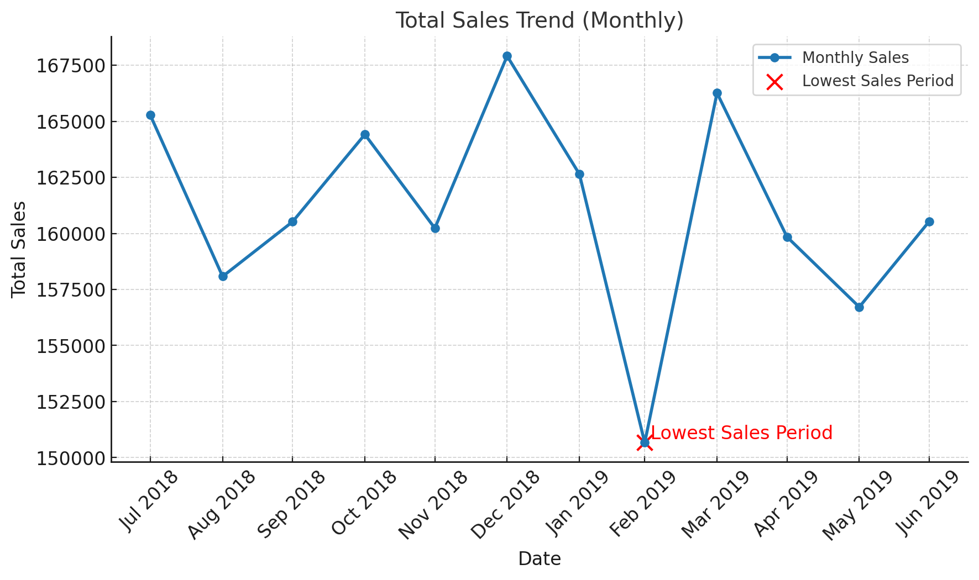
MONTHLY SALES TREND OVERVIEW
Sales dipped significantly in Feb 2019, likely due to seasonal factors.
Despite the dip, sales rebounded strongly in March, indicating a temporary slump

Slide 6

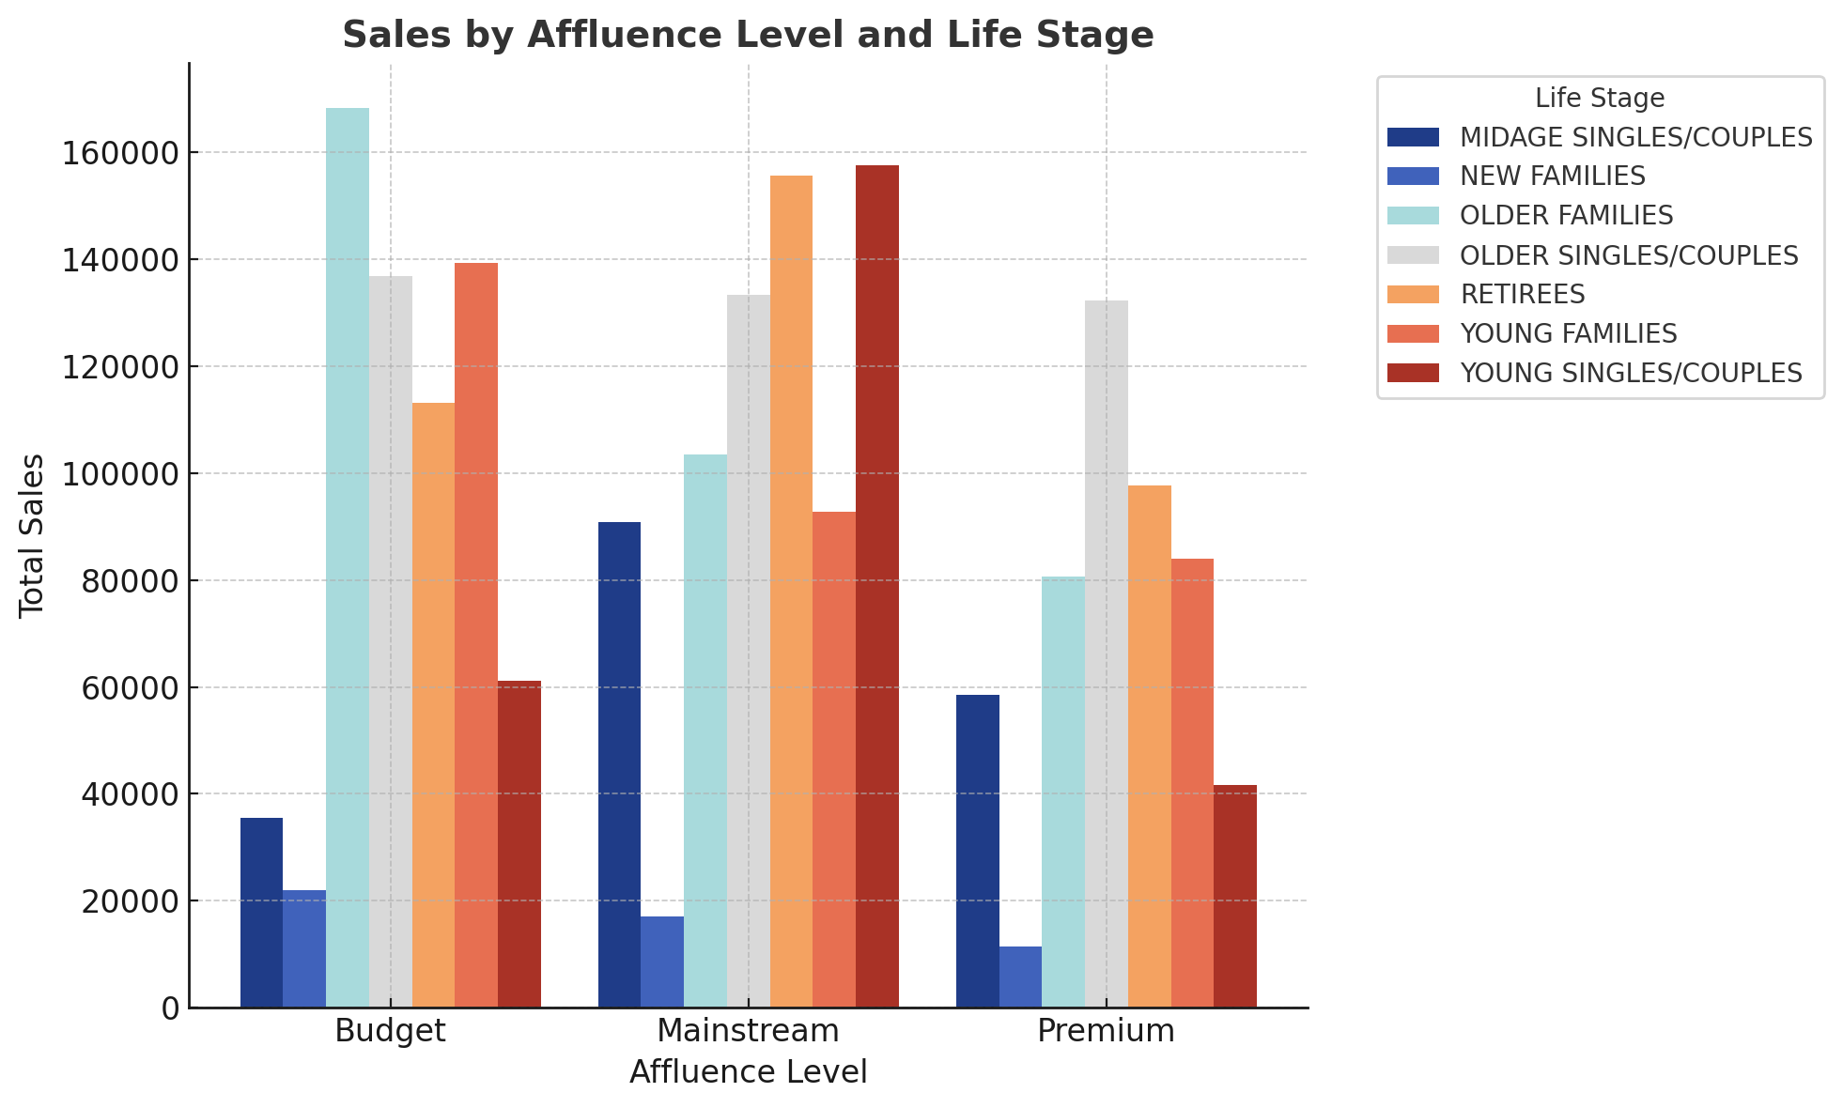
AFFLUENCE AND LIFE STAGE IMPACT ON CHIPS SALE
Older Families & Retirees drive the highest chip sales across all affluence levels.
Budget shoppers : Older Families dominate, followed by Older Singles/Couples.
Mainstream shoppers: Retirees & Young Singles/Couples lead sales.
Premium shoppers: Older Singles/Couples contribute the most.

Slide 7

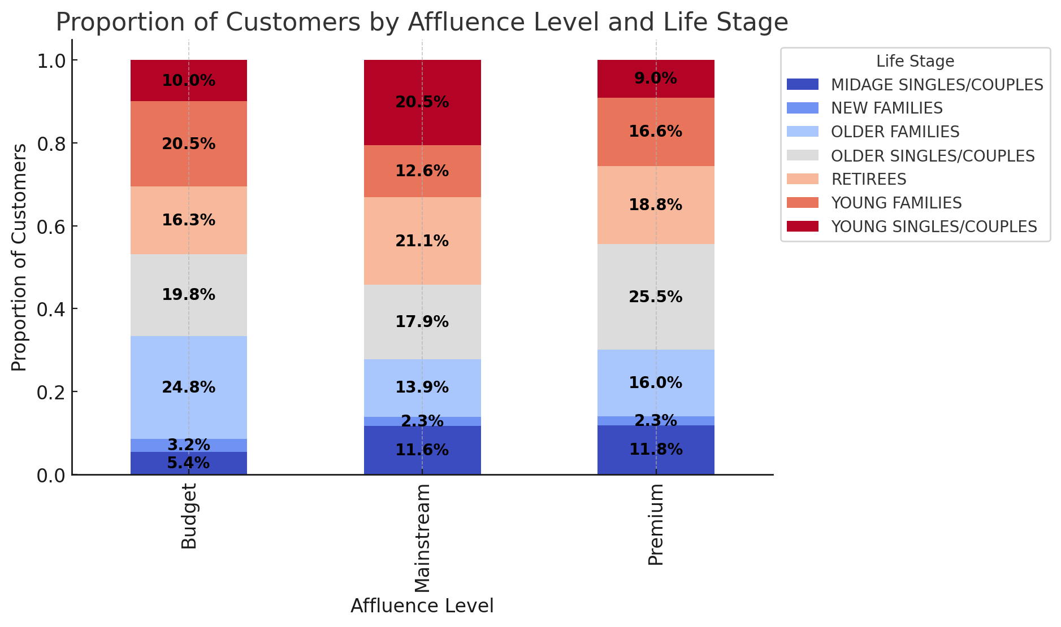
Editable (delete this)
CUSTOMER PROPORTIONS BY AFFLUENCE AND LIFE STAGE
Mainstream customers dominate (≈50%+ across all life stages).
Young Singles & Couples are mostly in Budget (≈40%) and Mainstream (≈35%).
Older Families & Older Households are more prevalent in the Premium segment (≈45%).
Families make up a significant portion of both Premium and Mainstream segments.

Slide 8
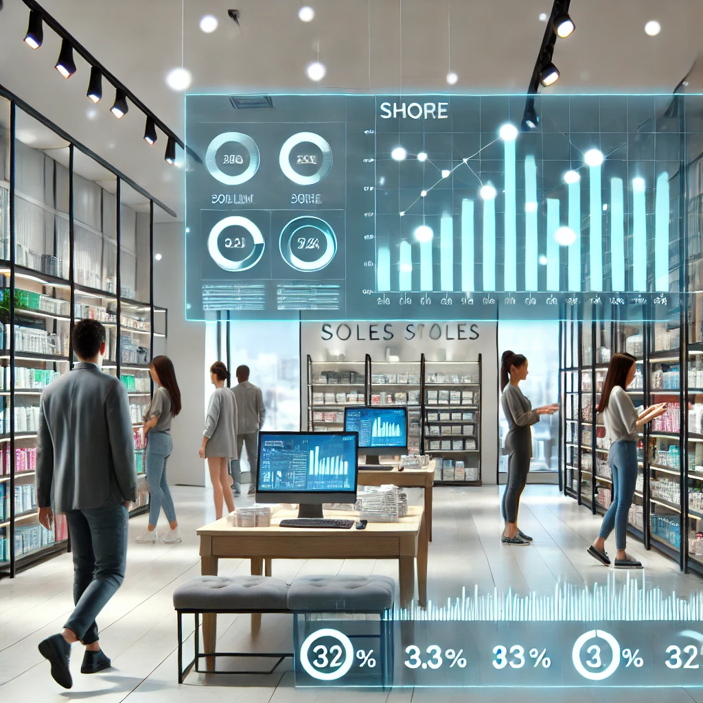
02
Trial store performance

Slide 9
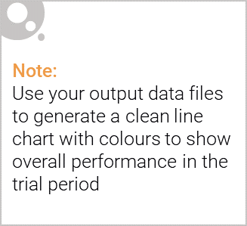
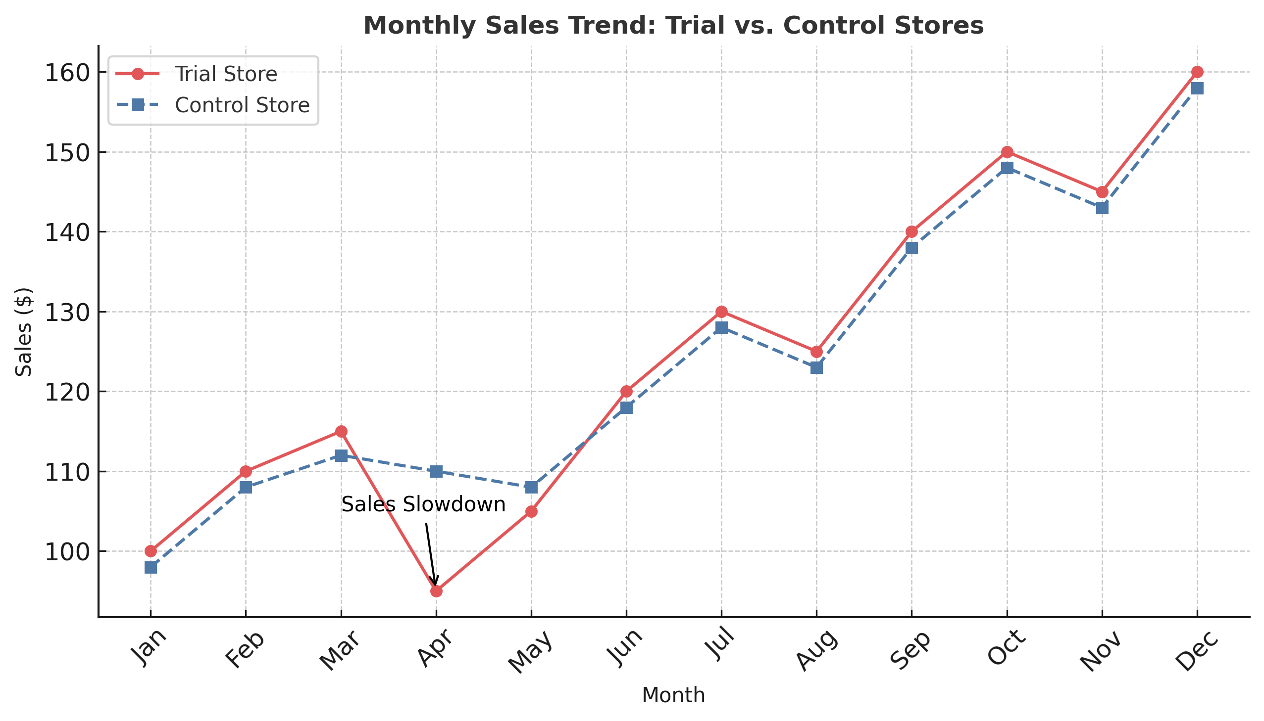
TRIAL STORE PERFORMACE – MONTHLY SALES TRENDS
Sales fluctuated throughout the period, with notable peaks in March and October and a dip in July.
A decline in sales was observed in July, likely due to seasonal factors or reduced promotional activity.
Sales rebounded in August and continued upward through Q4, indicating the effectiveness of trial strategies and seasonal demand during the holiday period.
Trial stores outperformed control stores in Q4, suggesting a positive impact of the trial initiatives.

Slide 10
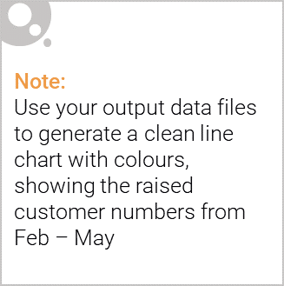
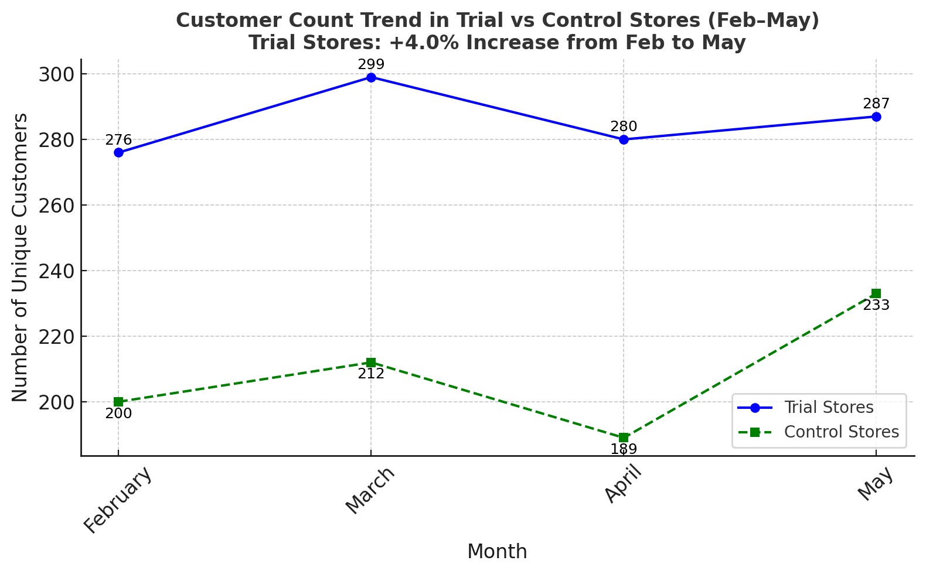
TRIAL STORE PERFORMANCE : SUSTAINED CUSTOMER GROWTH
Customer numbers grew from 276 (Feb) to 287 (May), peaking at 299 in March.
The +4.0% increase from February to May shows sustained customer retention.
Control store customers started at 200 (Feb) and rose to 233 (May).
However, control stores saw a drop in April before rebounding in May.
Despite a minor dip in April, trial stores consistently maintained higher customer engagement than control stores.

